Slide 1


Introduction to Operating Systems CS 1550
Spring 2023
Sherif Khattab
ksm73@pitt.edu
(Some slides are from Silberschatz, Galvin and Gagne ©2013)

Slide 2
Announcements
Upcoming deadlines
Homework 10 due this Friday
Project 3 due this Friday at 11:59 pm
Lab 4 due next Tuesday 4/11 at 11:59 pm

Slide 3
Previous Lecture …
How to allocate disk blocks to files and directories?
contiguous

Slide 4
This lecture …
How to allocate disk blocks to files and directories?
linked, FAT, indexed, and hybrid
How does a file system handle errors?

Slide 5
Enter File System!
How to allocate disk blocks to files and directories?

Slide 6
Linked allocation
File blocks form a linked list
Blocks may be scattered around in disk
Block has pointer to next block
Files grow as large as needed
Indexing is simple
Index node contains
First and last block
Length of file in bytes
Blocks allocated as needed
Linked into list of blocks
Removed from list of free blocks (or bitmap)
No wasted blocks - all blocks can be used
0
1
2
3
4
6
4
5
6
7
x
x
8
9
10
11
0
Start=9
End=4
Length=2902
Start=3
End=6
Length=1500

Slide 7
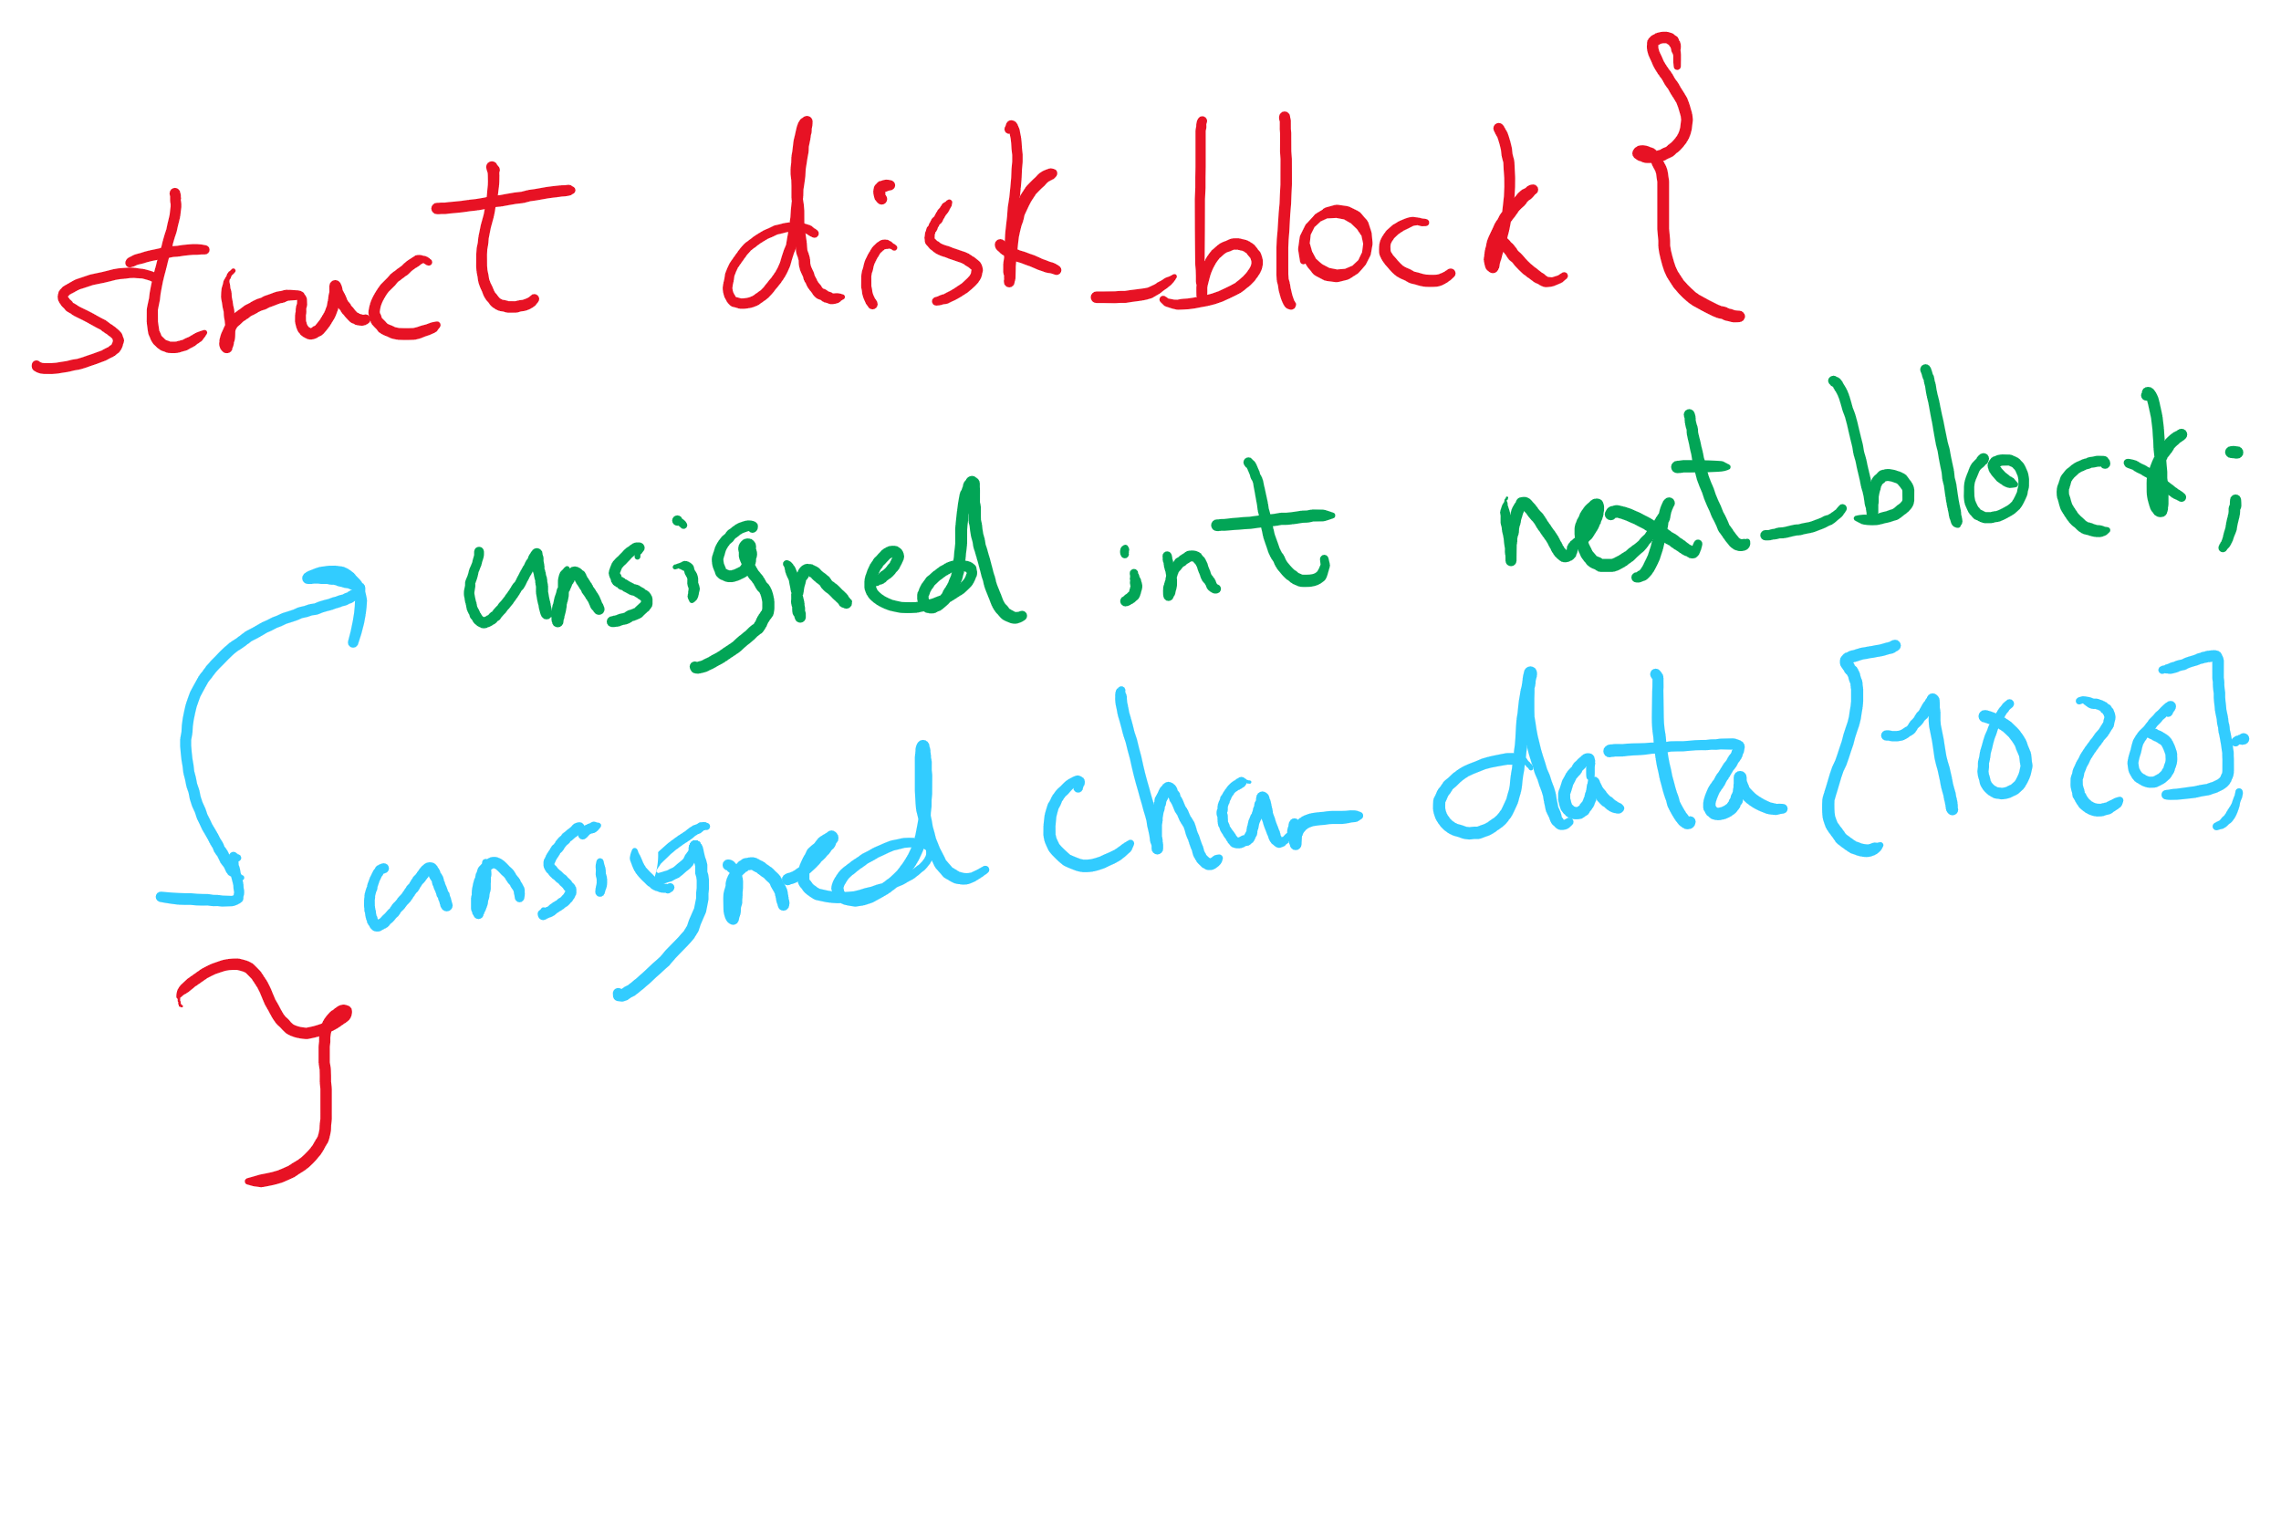
Data Structure for Linked Allocation

Slide 8
Logical to Physical Mapping
block = start logical_block_num = pos / block_size offset_in_block = pos % block_size for (j = 0; j < logical_block_num; j++) {
read disk block no. j into block block = block->next_block }
Assumes next block pointer stored at end of block. Why?

Slide 9
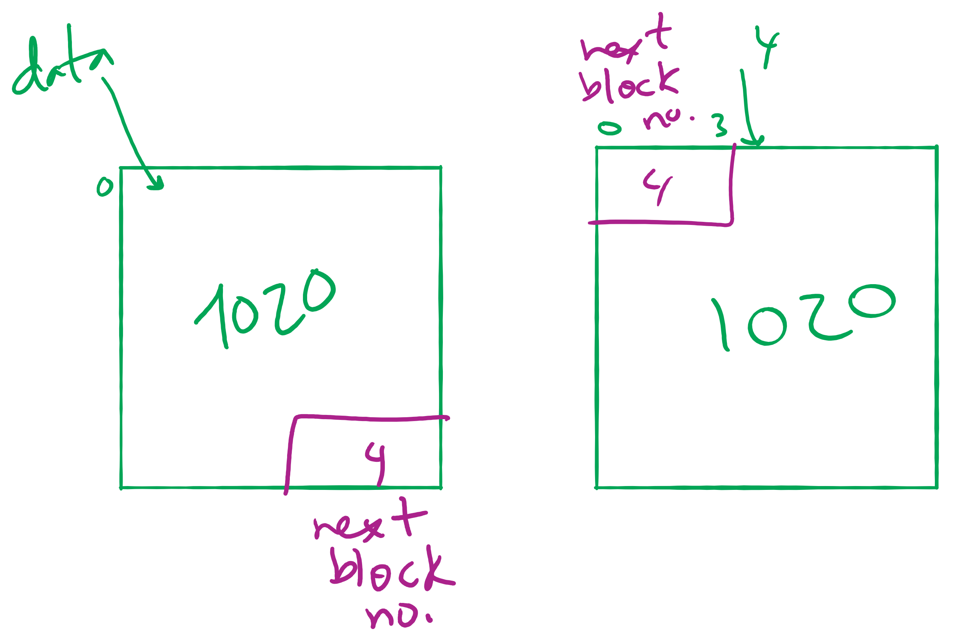
Offset Calculation

Slide 10
Linked allocation: Cons
Random access not possible
May require a long time for seek to random location in file
Overhead of next block pointers in each block

Slide 11
File Allocation Table (FAT)
Keep linked lists in memory
Advantage: faster
Disadvantages
Have to copy it to disk at some point
Have to keep in-memory and on-disk copy consistent
0
4
1
-1
2
-1
3
-2
4
-2
5
-1
6
3
B
7
-1
8
-1
9
0
A
0
1
2
3
10
-1
4
6
11
-1
4
5
6
7
12
-1
x
x
13
-1
8
9
10
11
14
-1
0
15
-1
File A
File B

Slide 12
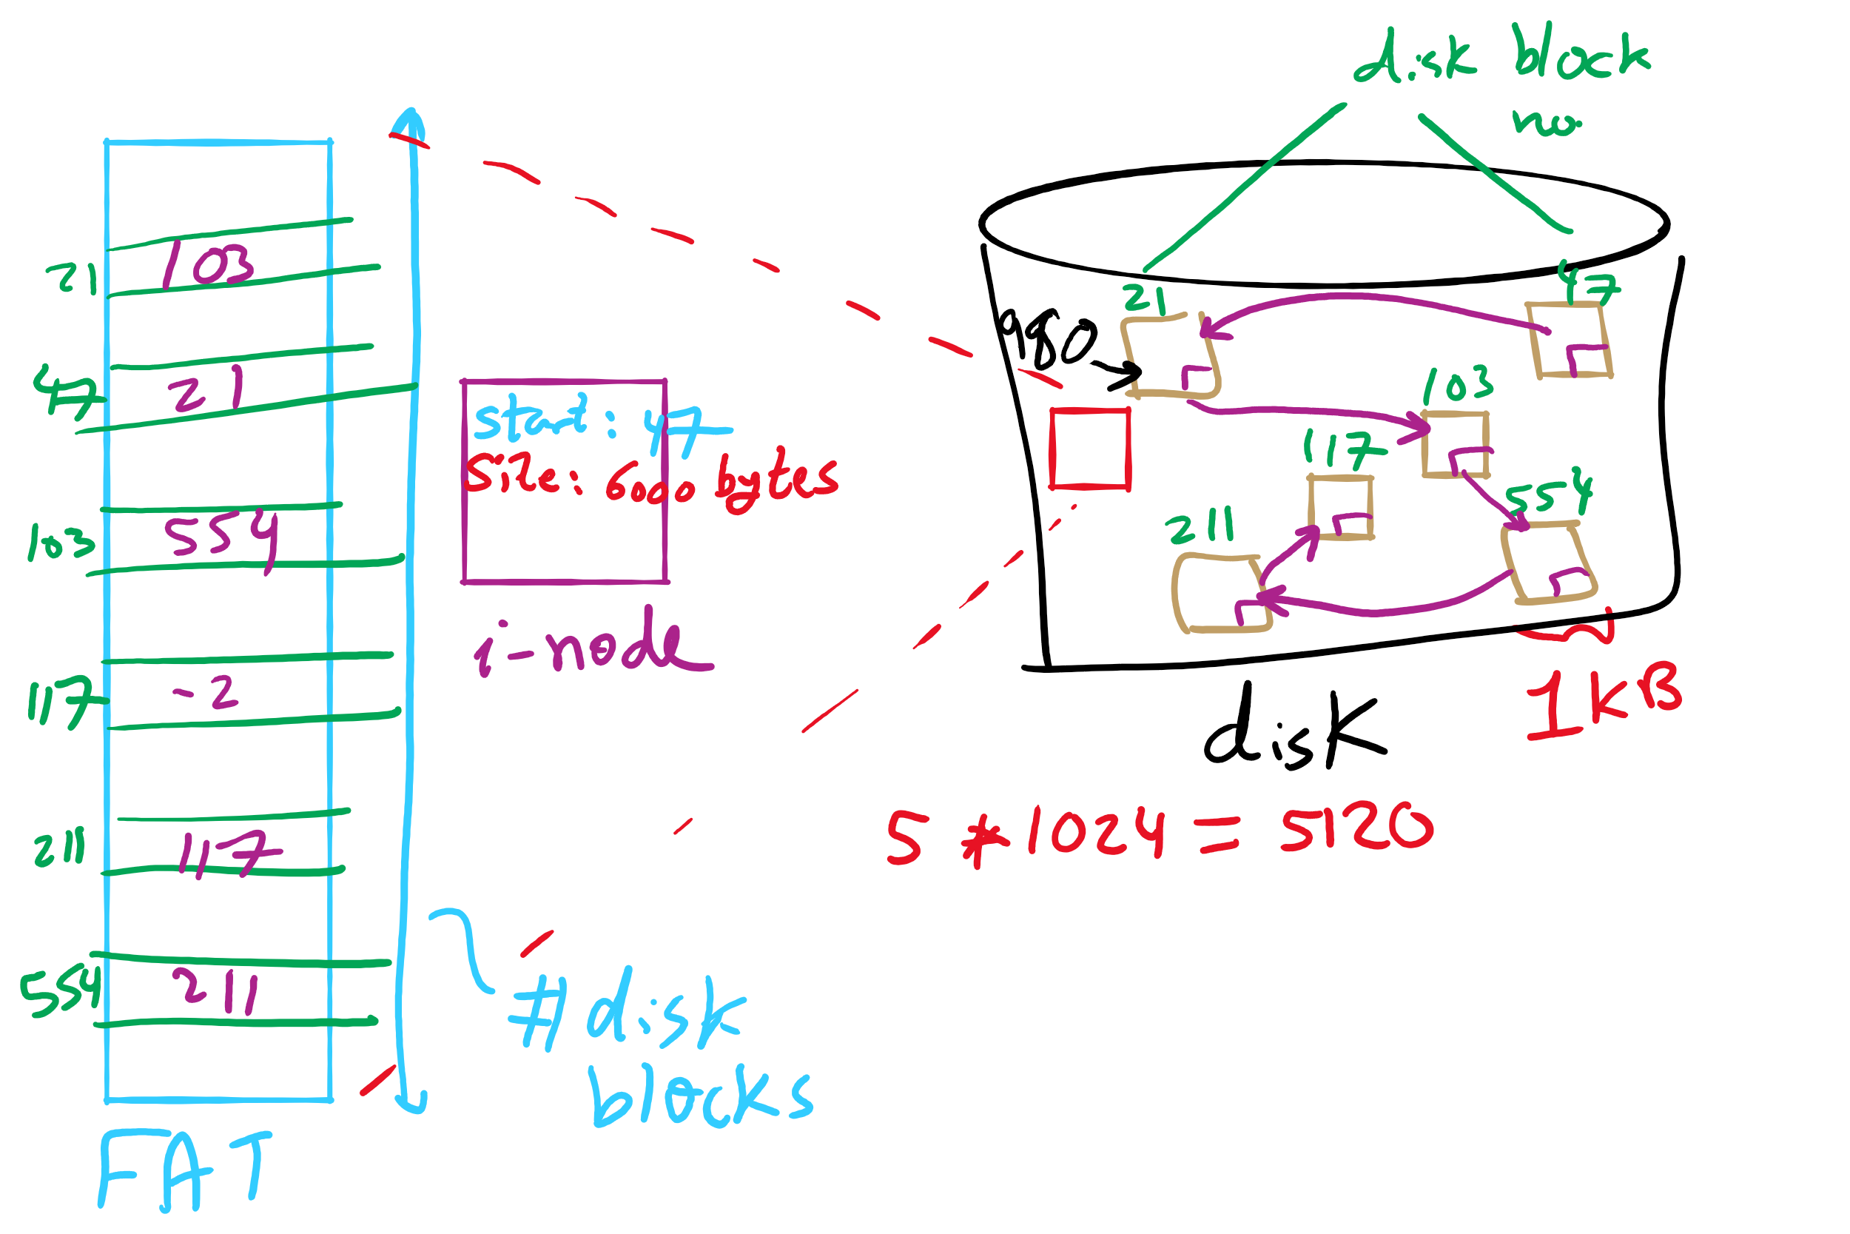
FAT Example

Slide 13
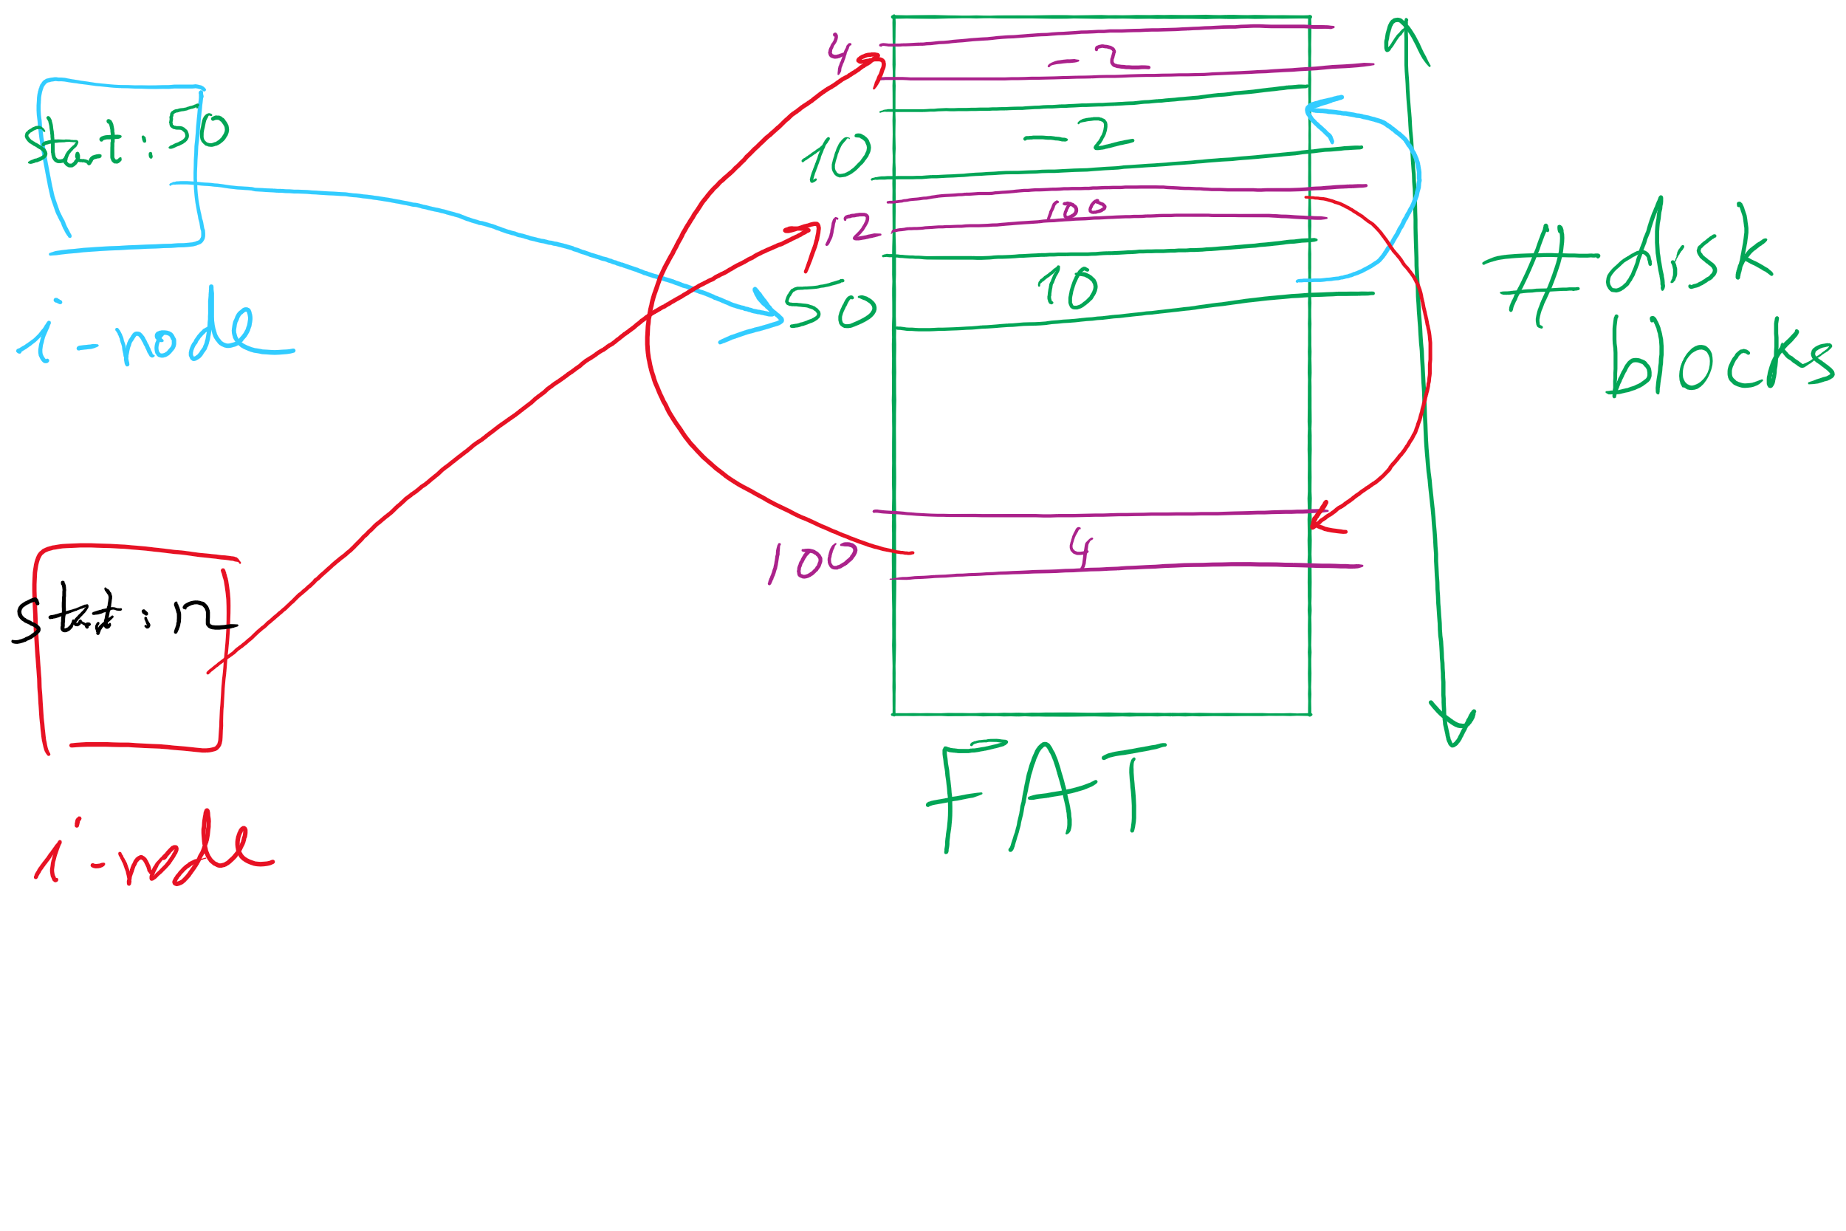
index nodes and FAT

Slide 14
Indexed Allocation
Store file block addresses in an array (called index)
Array itself is stored in a disk block
Index node has a pointer to index disk block
Non-existent blocks indicated by -1
Random access easy
Cons: Limit on file size!
Index Length
4 4802
0
1
2
3
6
9
7
0
8
4
5
6
7
8
9
10
11

Slide 15
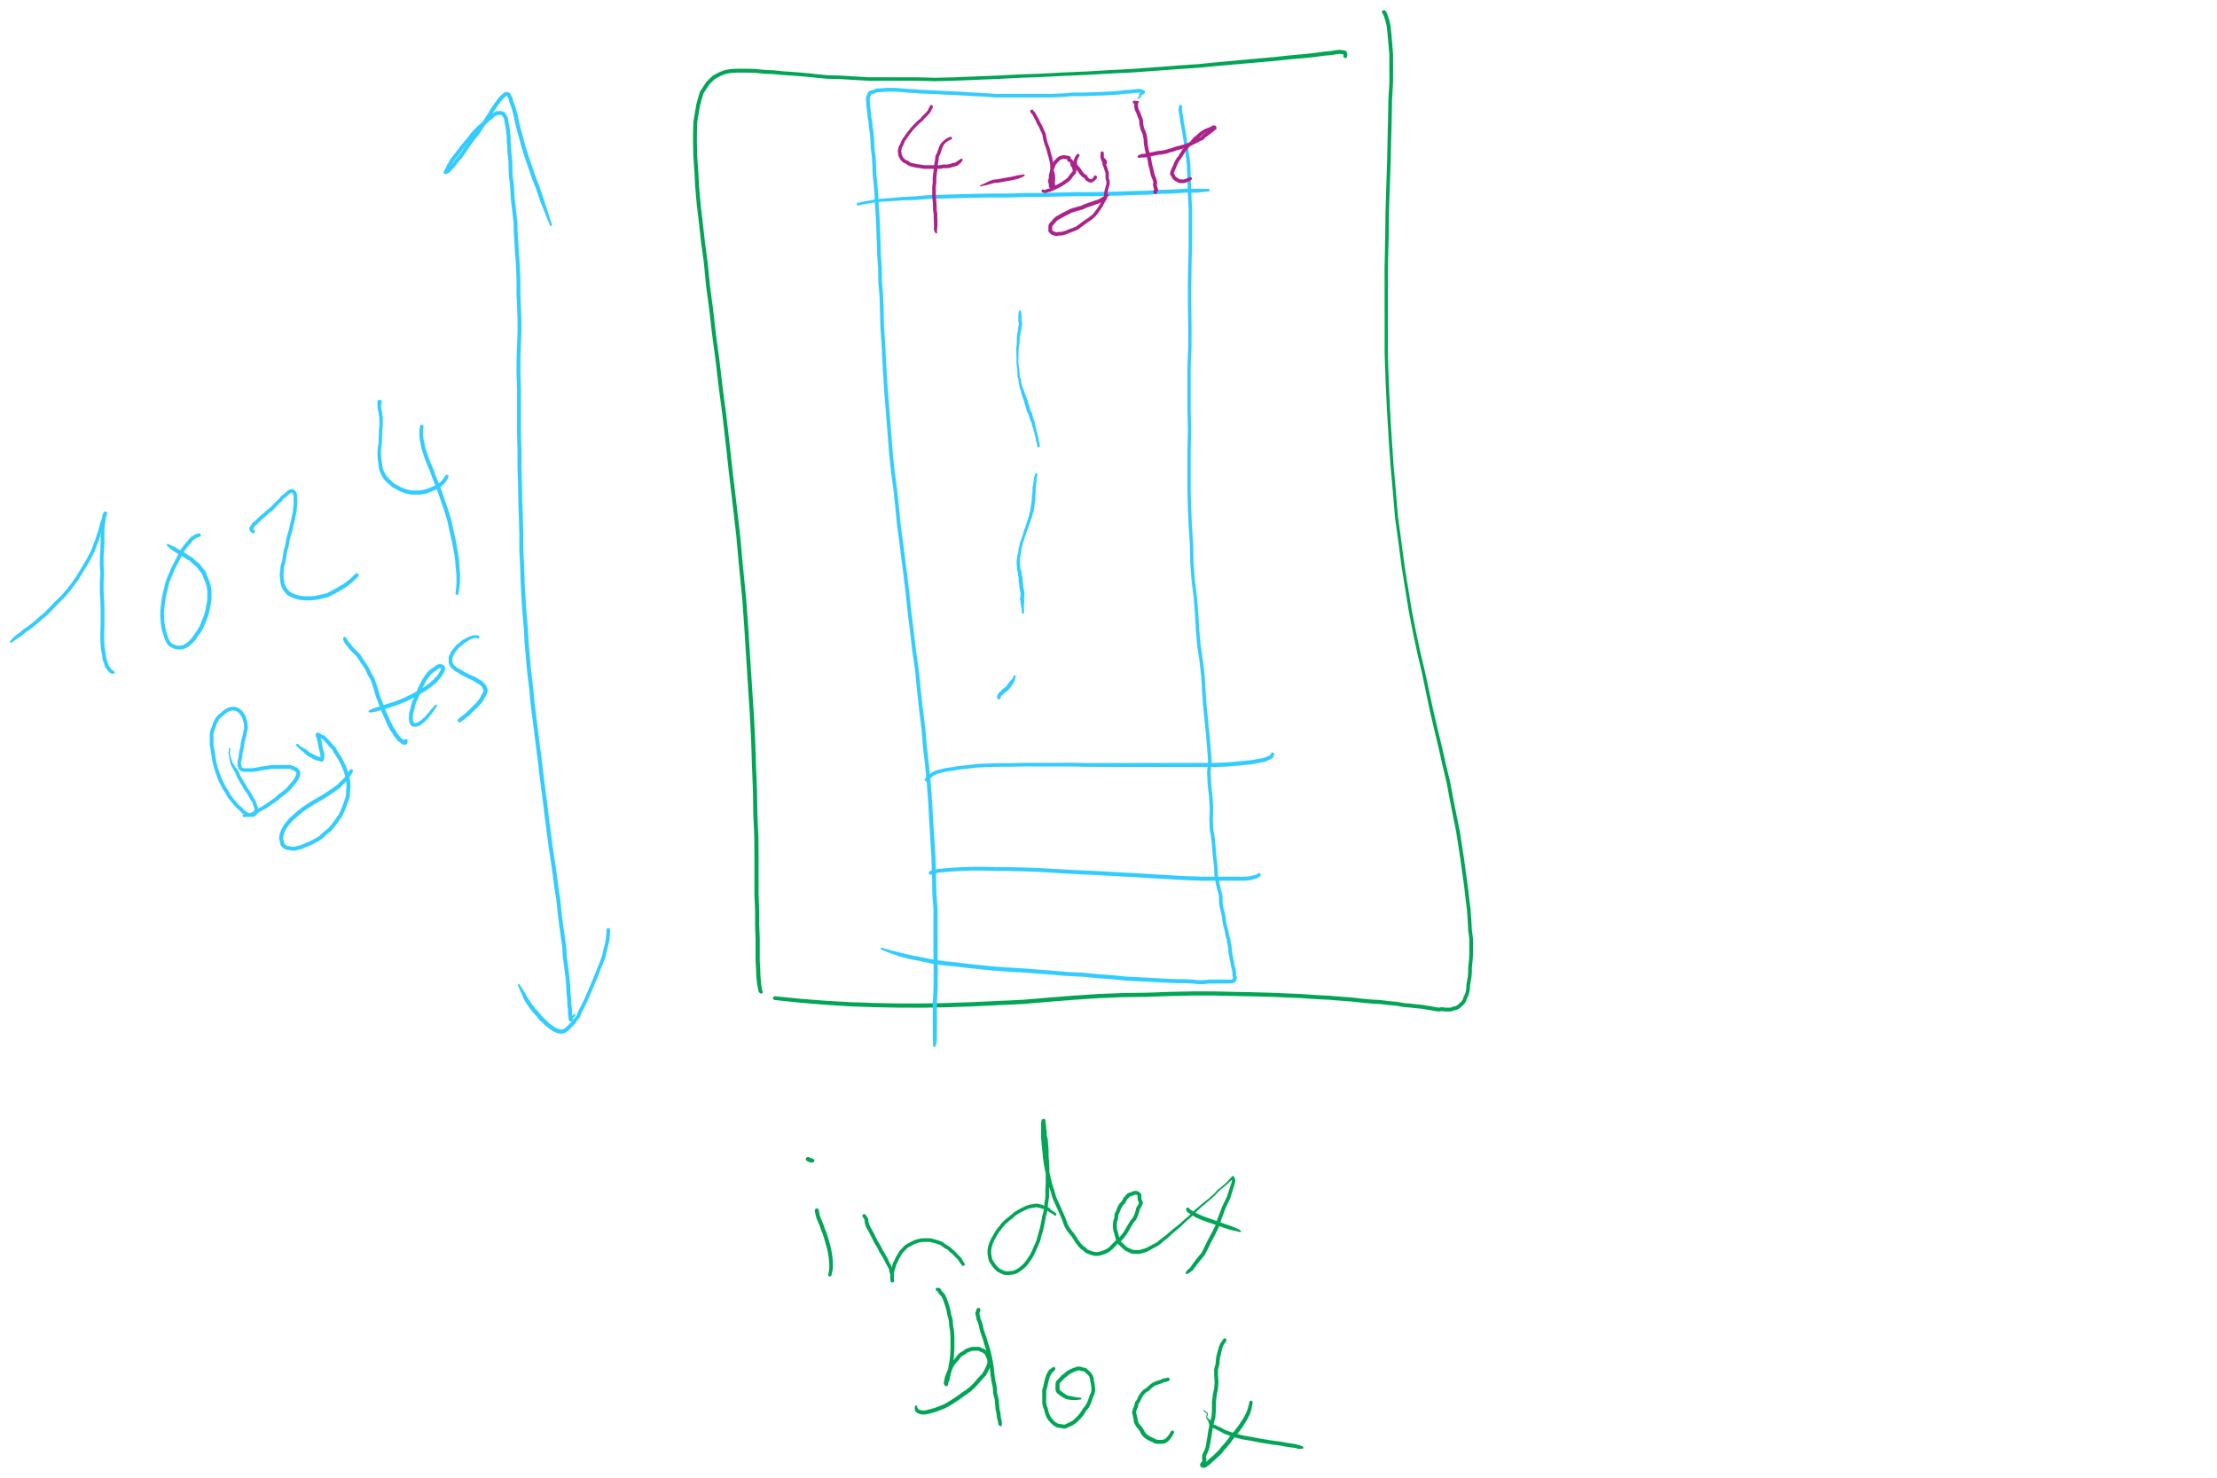
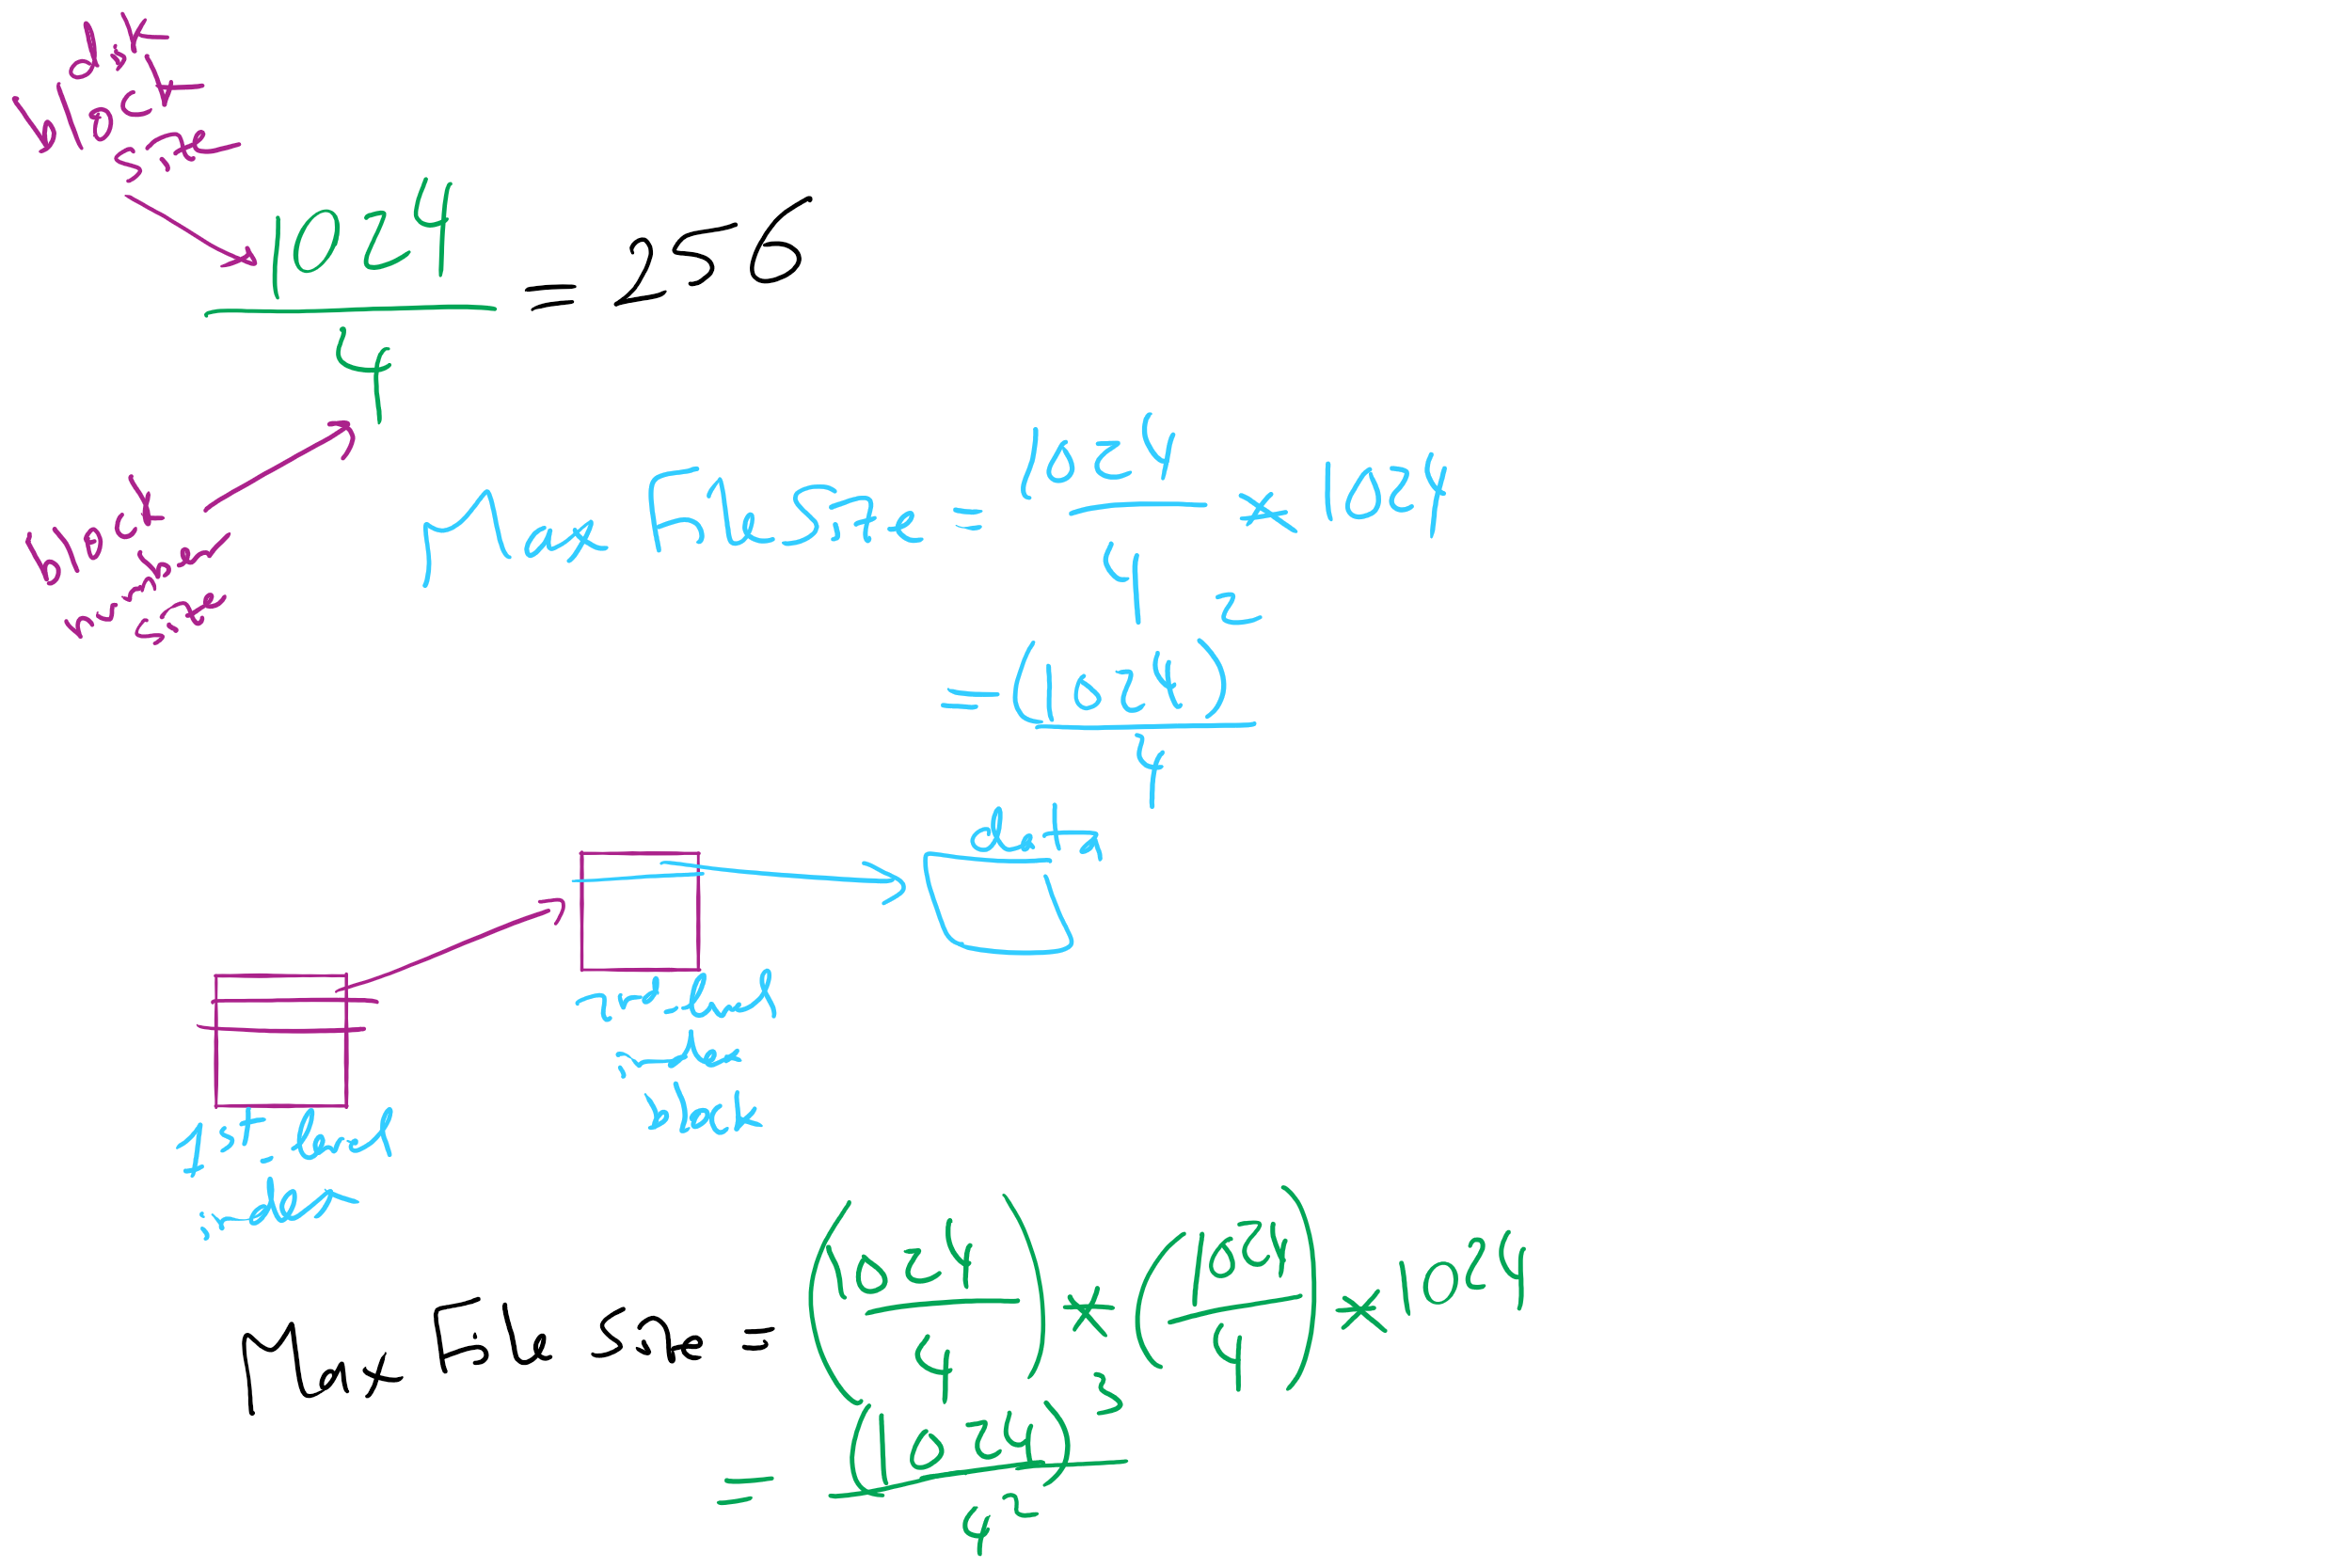
Max File Size for Indexed Allocation

Slide 16
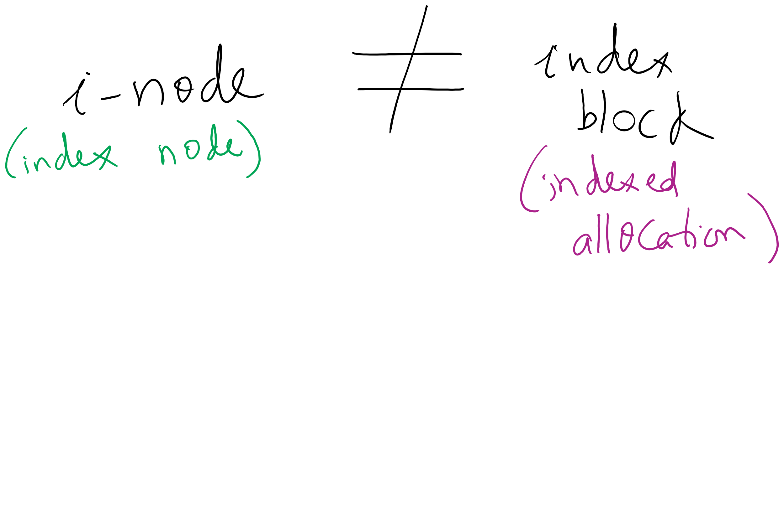
i-node vs index block

Slide 17
Hybrid Allocation (Lab 5)
Unix Fast File System indexing scheme
protection mode
data
owner & group
data
.
.
.
timestamps
size
data
block count
•
data
•
.
.
.
link count
•
Direct pointers
.
.
.
•
data
•
•
data
•
.
.
.
•
•
single indirect
•
•
data
double indirect
•
•
data
•
•
•
•
.
.
.
triple indirect
•
•
•
inode
•
•
•
data

Slide 18
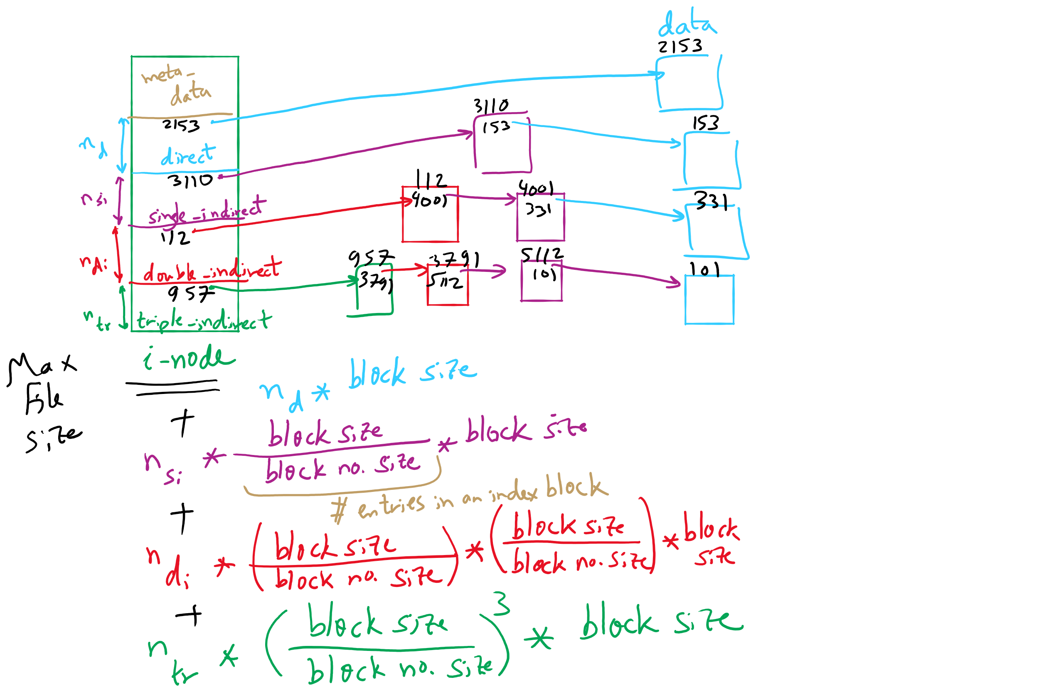
FFS Example

Slide 19
FFS and Max File Size

Slide 20
What’s in a file directory?
Two types of information needed about a file
File names
File metadata (size, timestamps, disk block locations)
Basic choices for directory information
Store all information in directory
Fixed size entries
Disk addresses and attributes in directory entry
Store names & pointers to index nodes (i-nodes)
attributes
games
attributes
games
mail
attributes
mail
attributes
news
attributes
news
attributes
research
attributes
research
Storing all information in the directory
Using pointers to index nodes
attributes

Slide 21
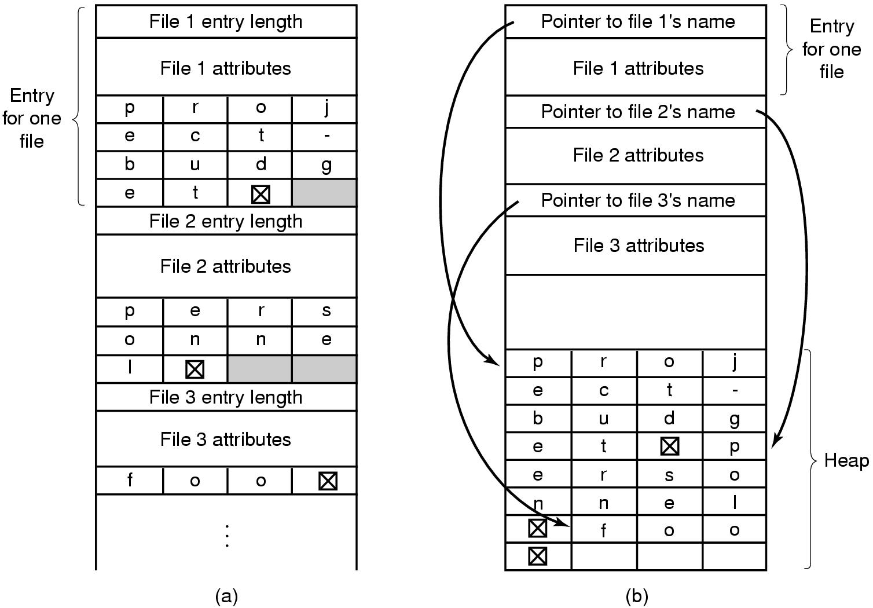
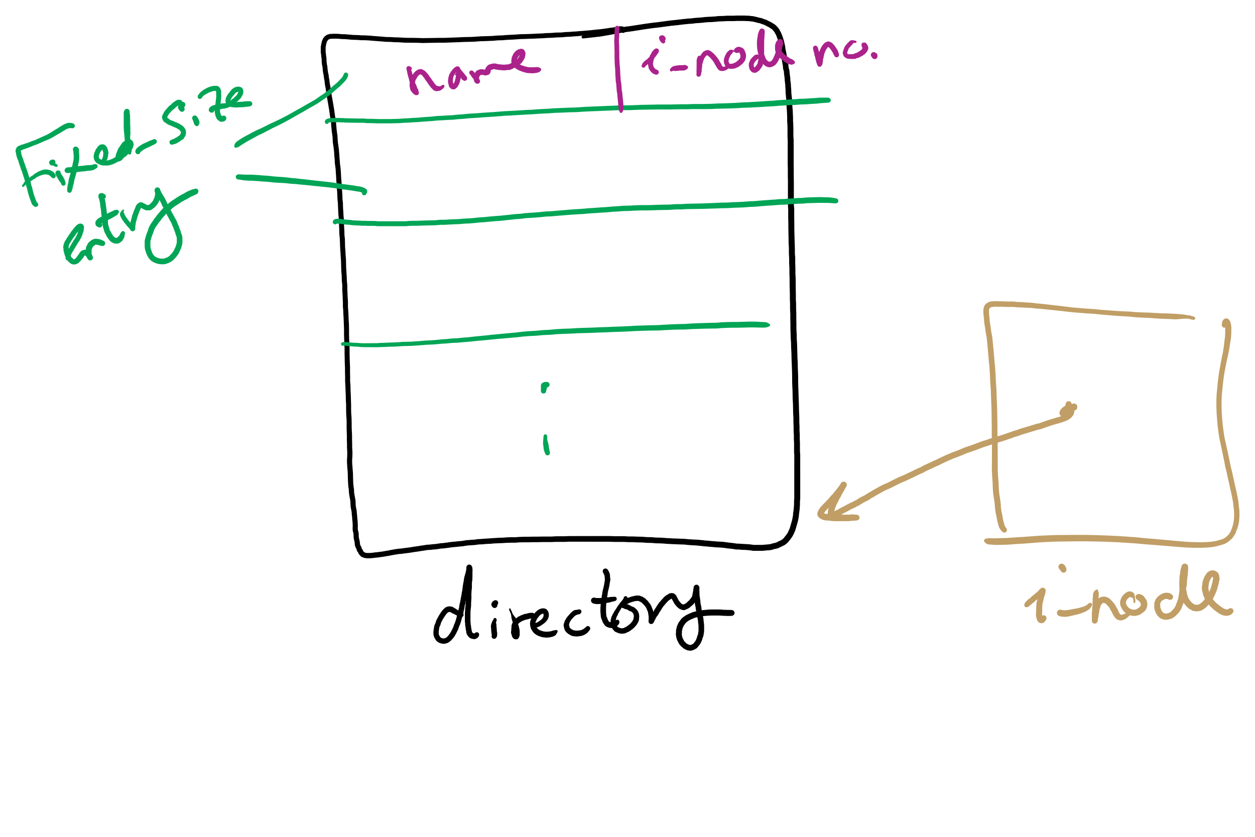
Handling long file names in a directory

Slide 22
Free Block Tracking
10

Slide 23
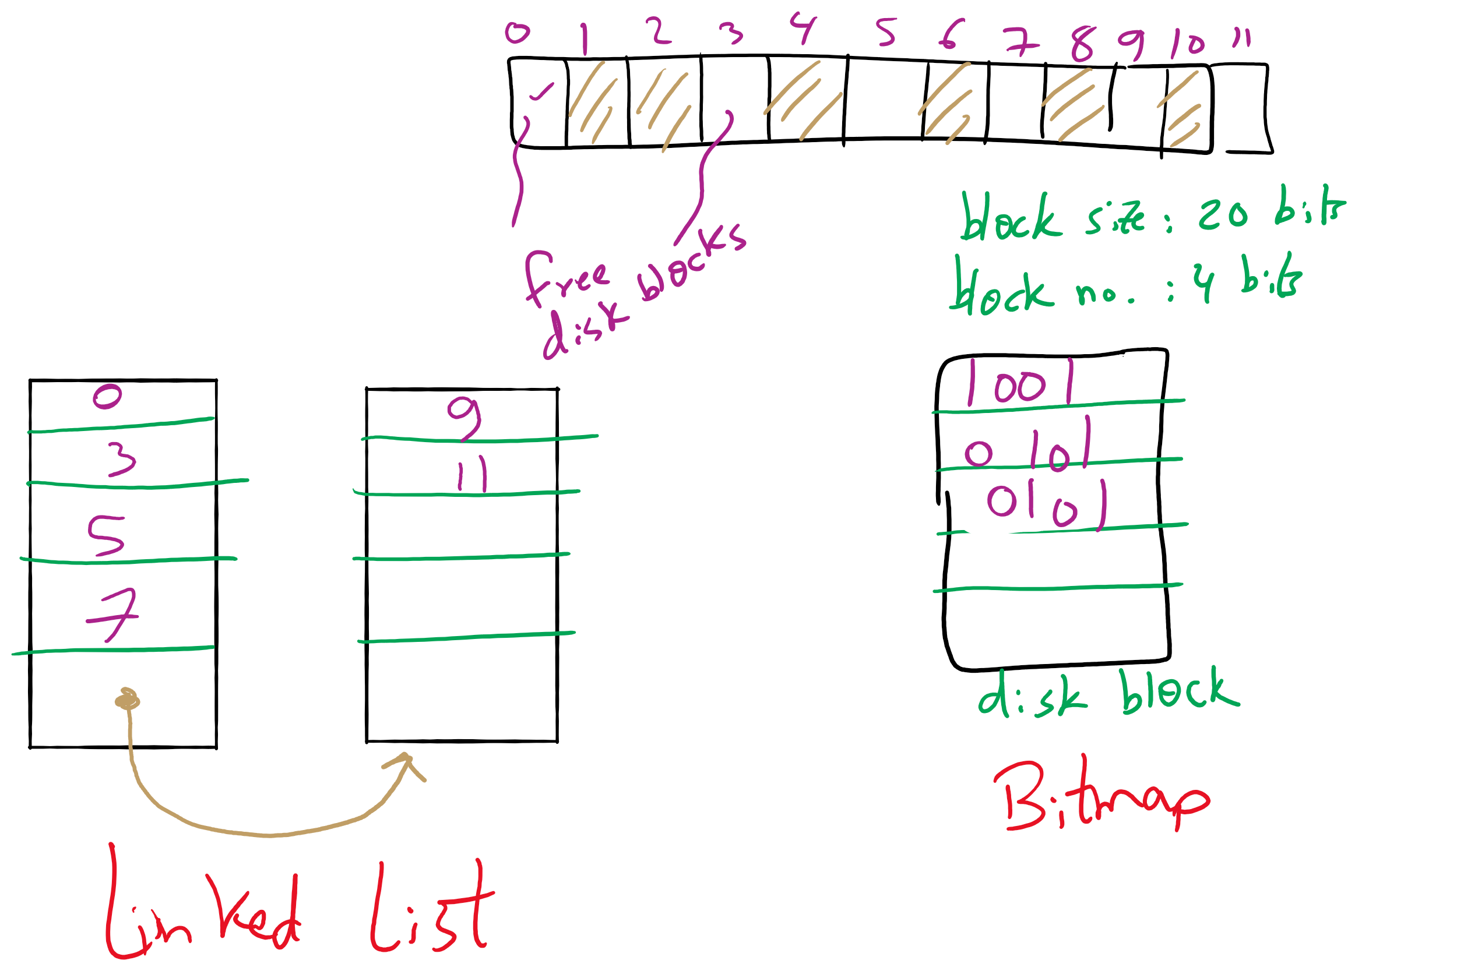
Free Block Tracking Example 1

Slide 24
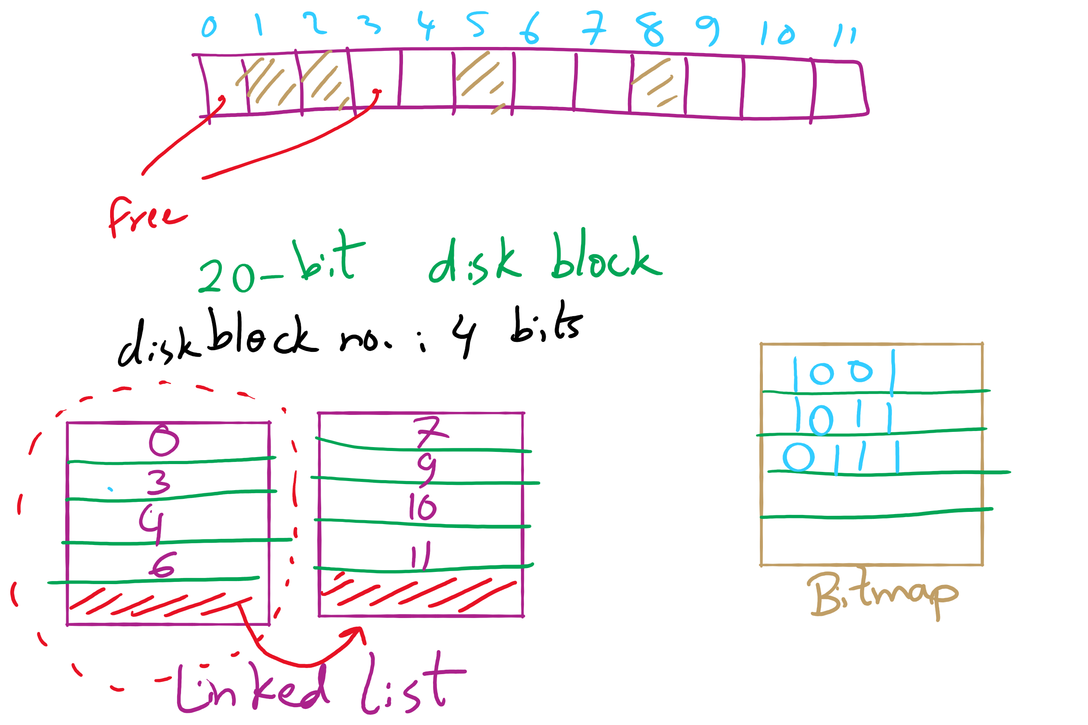
Free Block Tracking Example 2

Slide 25
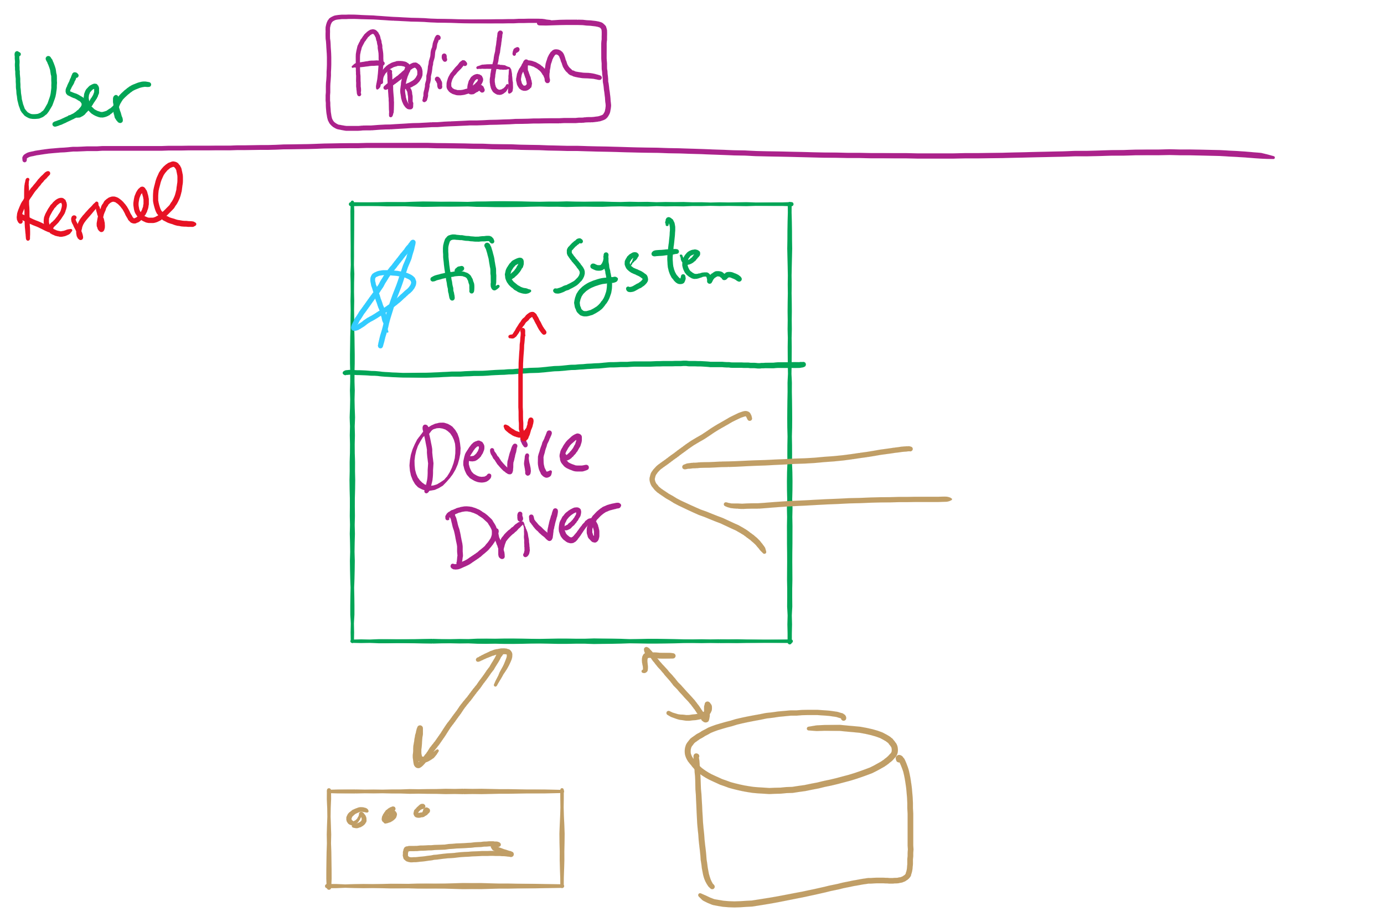
Software Layers

Slide 26
Problem of the Day
How does a file system handle errors?
Answer: Defense in Depth
multiple layers of error detection/correction

Slide 27
Device drivers
Device drivers go between device controllers and rest of OS
Drivers standardize interface to widely varied devices
Device drivers communicate with controllers over bus
Controllers communicate with devices themselves
User space
User program
Kernel space
Rest of the OS
Keyboard driver
Disk driver
Keyboard controller
Disk controller

Slide 28
Layers of I/O software
User-level I/O software & libraries
User
Device-independent OS software
Operating system (kernel)
Device drivers
Interrupt handlers
Hardware

Slide 29
Device Driver goals
Device independence
Programs can access any I/O device
No need to specify device in advance
Uniform naming
Name of a file or device is a string or an integer
Doesn’t depend on the machine (underlying hardware)
Error handling
Done as close to the hardware as possible
Isolate from higher-level software
Synchronous vs. asynchronous transfers
Blocked transfers vs. interrupt-driven
Buffering
Data coming off a device cannot be stored in final destination right away
Arbitration of device access
Sharable vs. dedicated devices

Slide 30
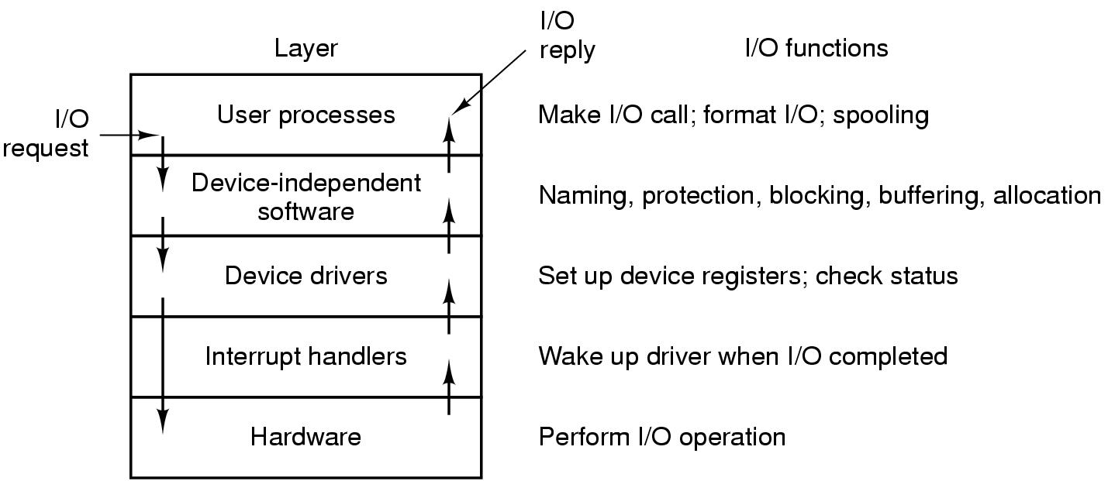
Anatomy of an I/O request

Slide 31
Disk drive structure
Data stored on surfaces
One or more platters per disk
Up to two surfaces per platter
Data in concentric tracks
Tracks broken into sectors
256B-1KB per sector
Cylinder: corresponding tracks on all surfaces
Data read and written by heads
Actuator moves heads
Heads move in unison
head
sector
platter
track
cylinder
surfaces
spindle
actuator

Slide 32
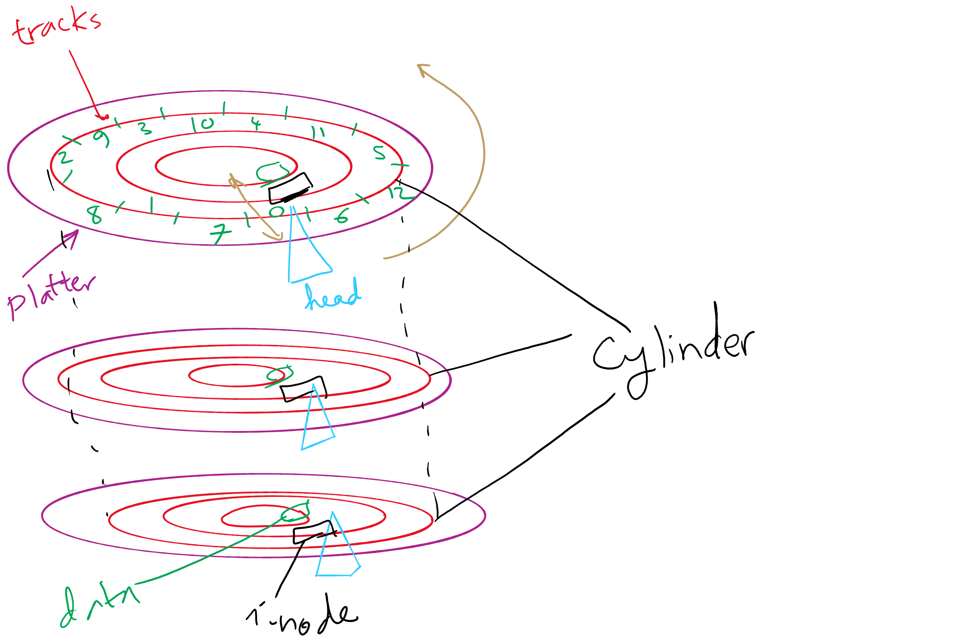
Disks, cylinders, cylinder groups

Slide 33
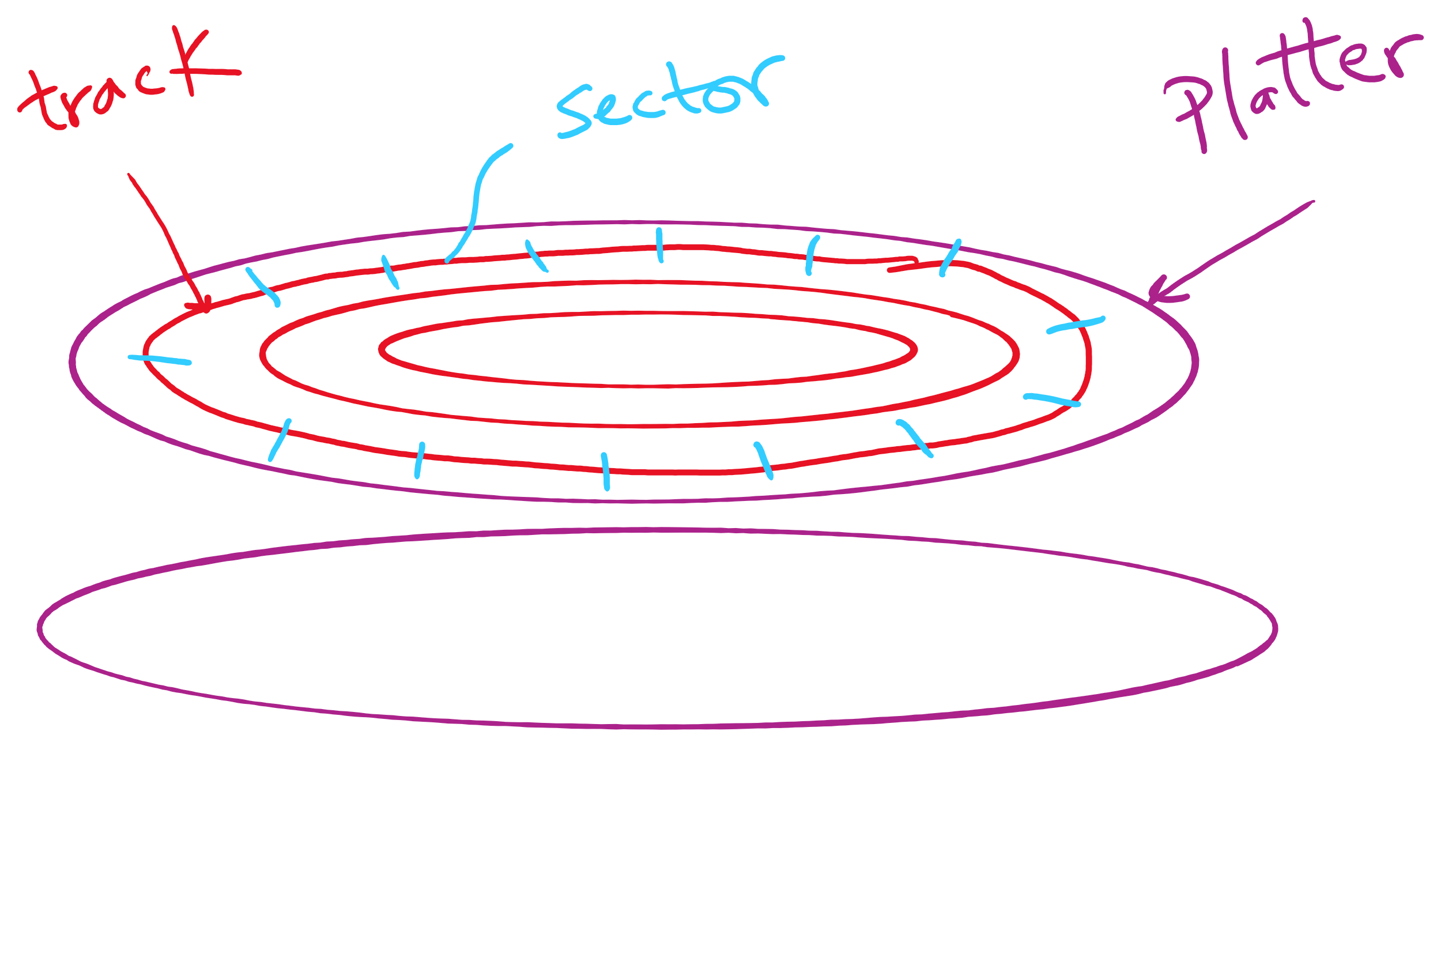
Disk Sector

Slide 34
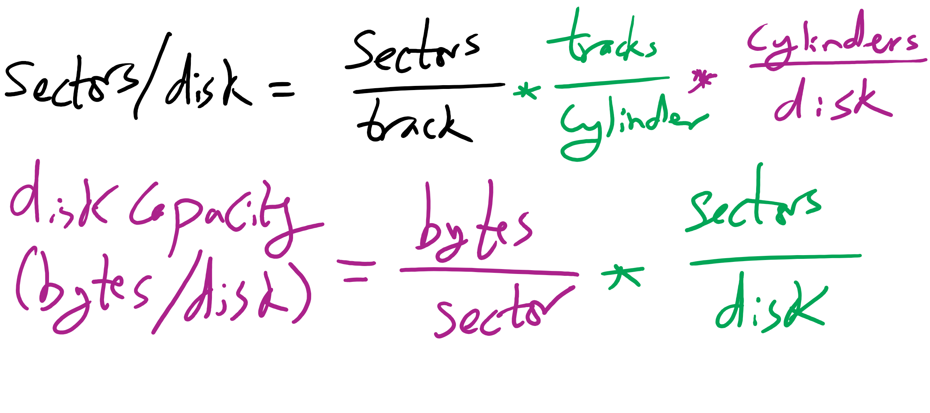
Disk Size

Slide 35
What’s in a disk request?
Time required to read or write a disk block determined by 3 factors
Seek time: move disk arm to track
Rotational delay
Average delay = 1/2 rotation time
Example: one rotation in 10ms → average rotational delay = 5ms
Actual transfer time
Transfer time = time to rotate sector(s) under the heads
Example: one rotation in 10ms, 200 sectors/track
10/200 ms = 0.05ms transfer time per sector
Seek time dominates, with rotation time close

Slide 36
Intelligent Seek (IntelliSeek)
Sometimes we don’t need to move disk arm at max speed during seek time
Adjust disk arm speed so that it reaches track right before needed sector is under the head
head
sector
platter
track
cylinder
surfaces
spindle
actuator

Slide 37
Disk drive specifics
 | IBM 360KB floppy | WD 18GB HD
Cylinders | 40 | 10601
Tracks per cylinder | 2 | 12
Sectors per track | 9 | 281 (average)
Sectors per disk | 720 | 35742000
Bytes per sector | 512 | 512
Capacity | 360 KB | 18.3 GB
Seek time (minimum) | 6 ms | 0.8 ms
Seek time (average) | 77 ms | 6.9 ms
Rotation time | 200 ms | 8.33 ms
Spinup time | 250 ms | 20 sec
Sector transfer time | 22 ms | 17 μsec

Slide 38
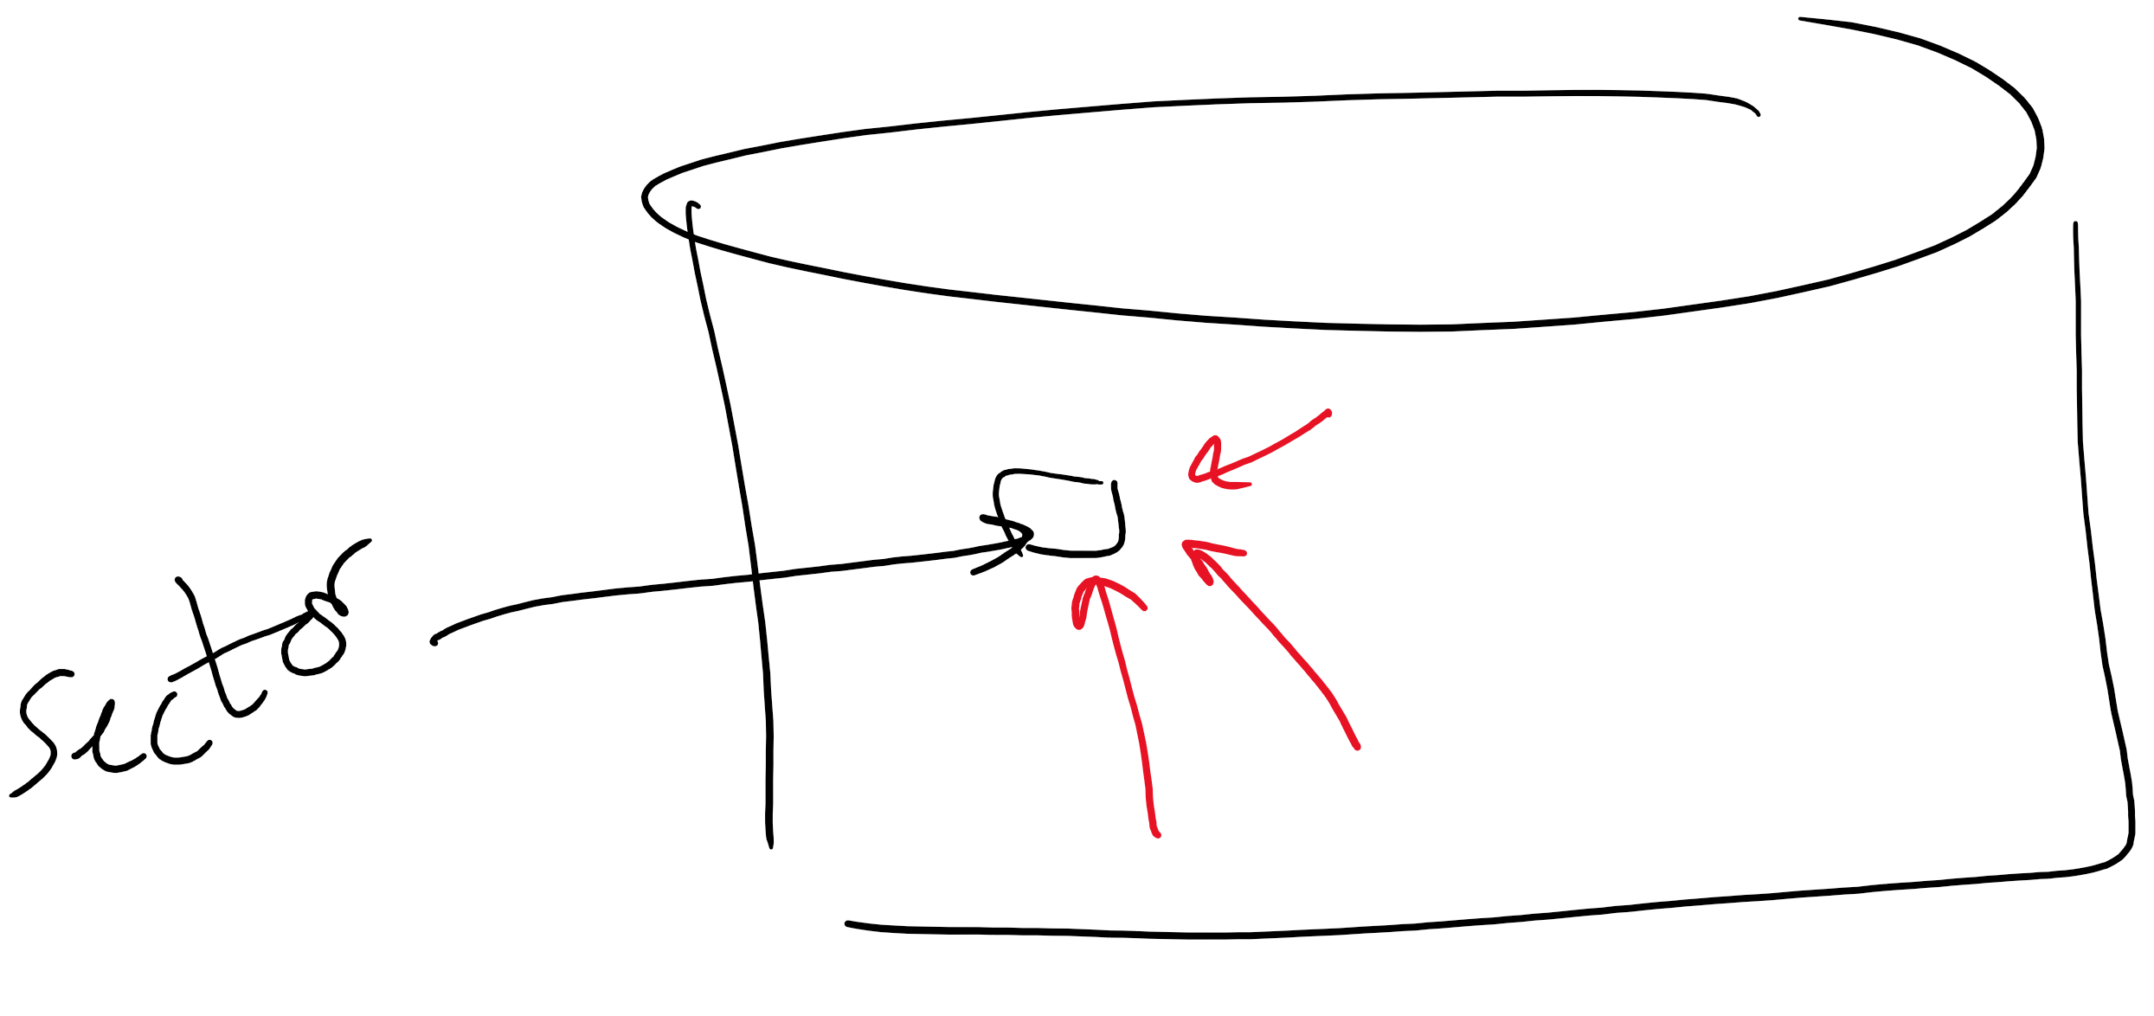
Structure of a disk sector
Preamble contains information about the sector
Sector number & location information
Data is usually 256, 512, or 1024 bytes
ECC (Error Correcting Code) is used to detect & correct minor errors in the data
Preamble
Data
ECC

Slide 39
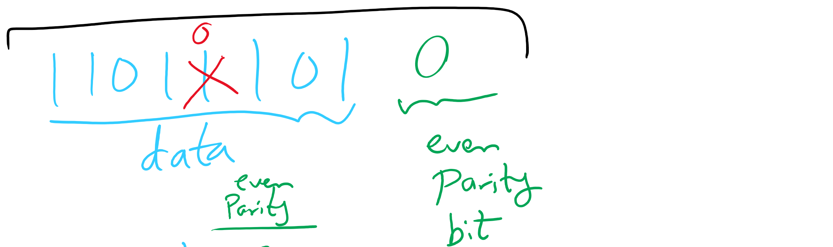
Parity Bit
One parity bit can detect single-bit errors

Slide 40
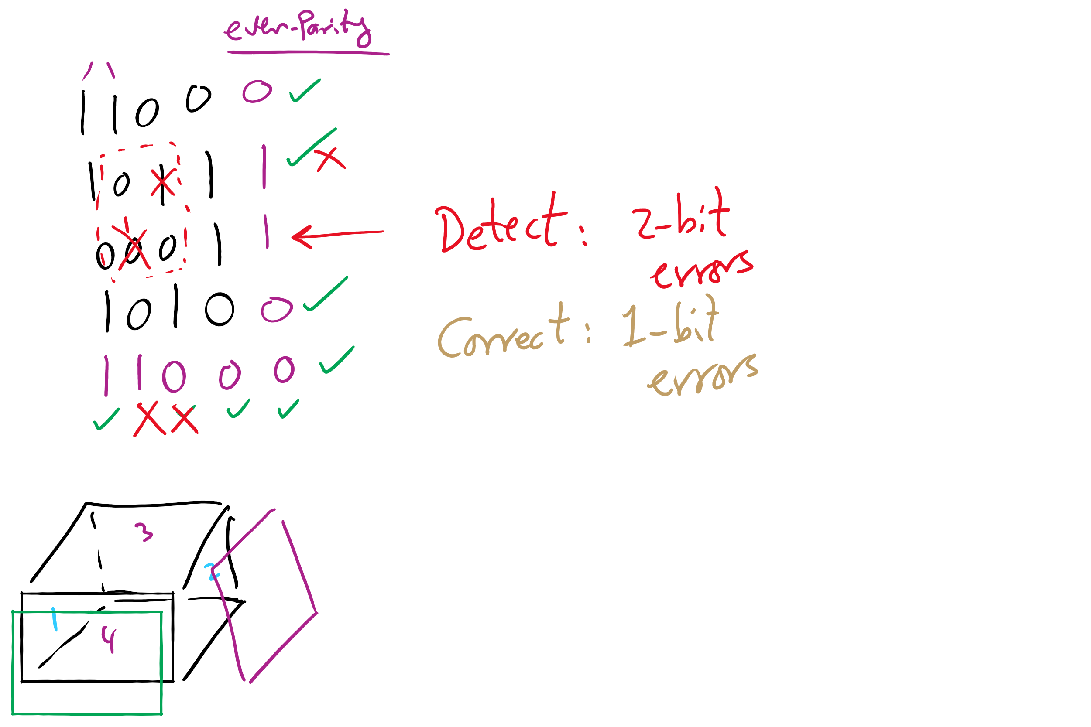
Two-Dimensional Parity Bits

Slide 41
Three-Dimensional Parity Bits
Detect up to 3-bit errors
Correct up to 2-bit errors

Slide 42
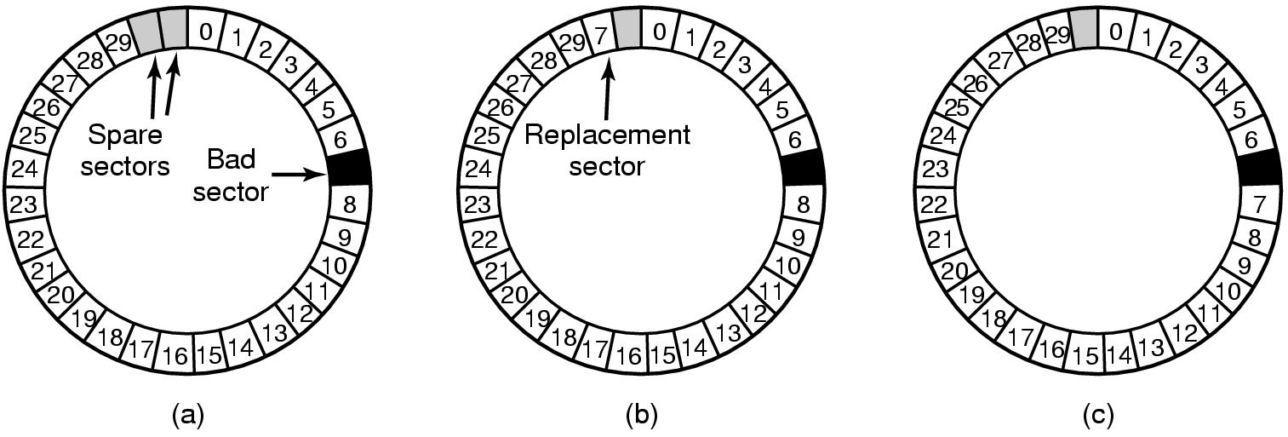
When good disks go bad…
Disks have defects
In 3M+ sectors, this isn’t surprising!
ECC helps with errors, but sometimes this isn’t enough
Disks keep spare sectors (normally unused) and remap bad sectors into these spares
If there’s time, the whole track could be reordered…

Slide 43
What if an entire disk goes bad?
Stripe
strip
strip
RAID 0
(Redundant Array of Inexpensive Disks
RAID 1
(Mirrored copies)
RAID 4
(Striped with parity)
RAID 5
(Parity rotates through disks)

Slide 44
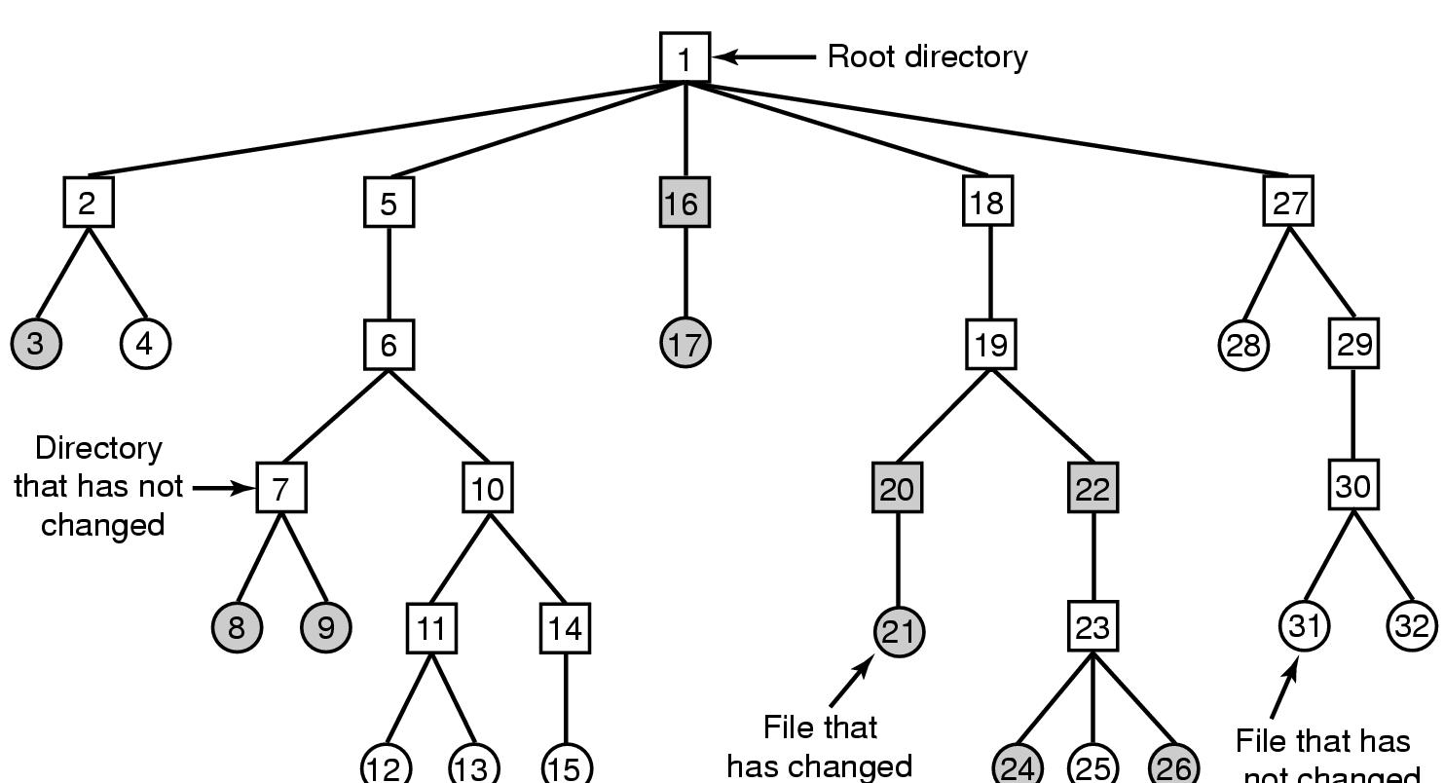
What if RAID cannot mask an error?
Solution: Backing up a file system (aka dumping)
Expensive operation → done incrementally
Track items modified since last dump (shaded)
Numbers are i-node numbers
File that has
not changed

Slide 45
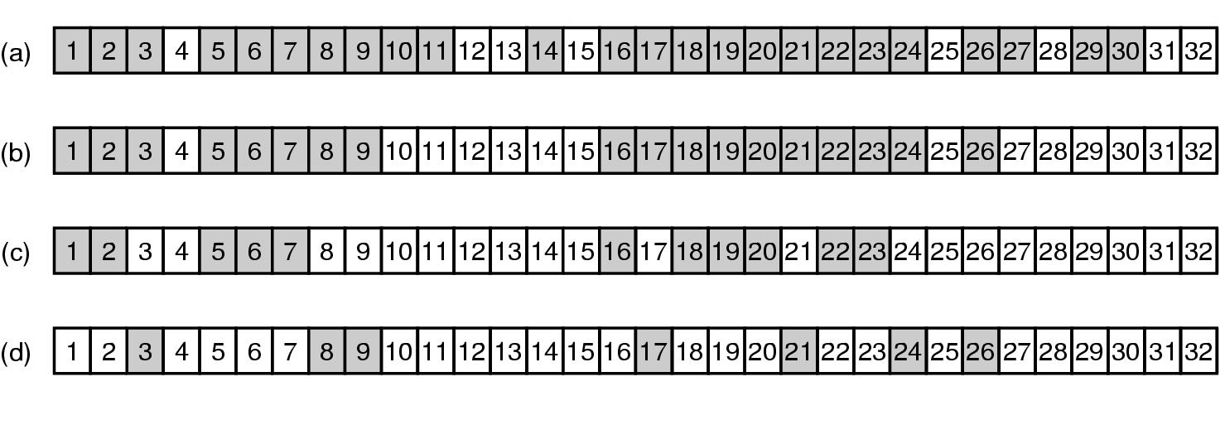
Incremental dump using bitmaps

Slide 46
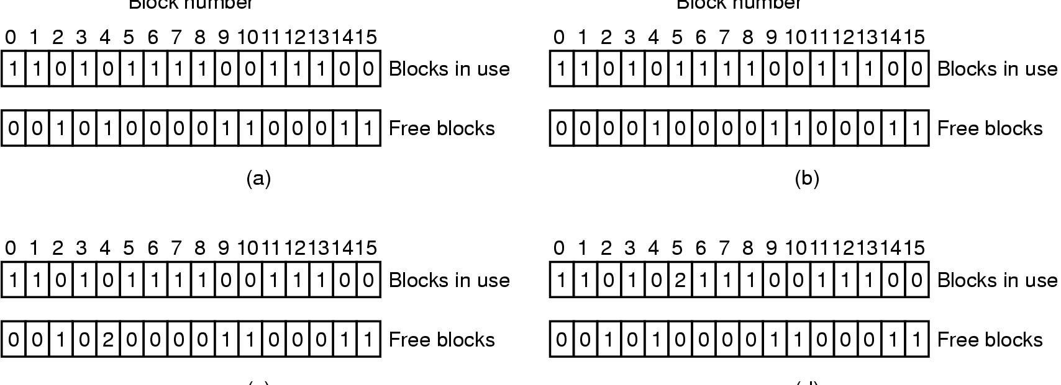
What if errors happen in metadata?
Reason: power failure during an operation
file system consistency check
Consistent
Missing (“lost”) block
Duplicate block in free list
Duplicate block in two files

